Slide 1

BETWEEN TWO CHURNS, INC
(Don't) Feel the Churn

Slide 3

Conference Call Plan
WHAT WE'RE COVERING
State Churns
Churners
Modeling
Identifying Important Features
Observations
Recommendations
Next Steps

Slide 4
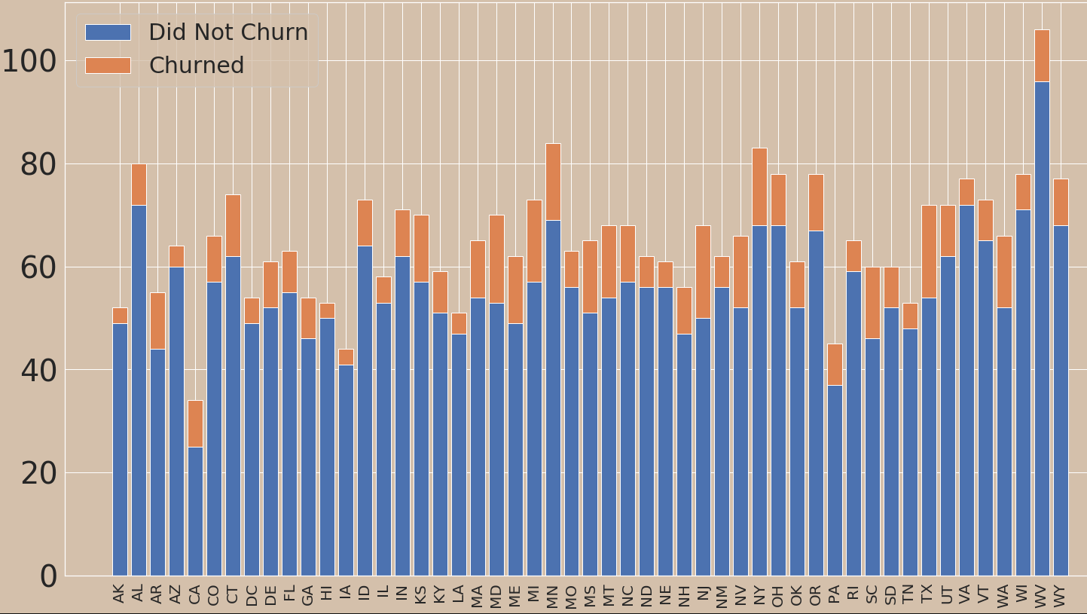
State Churns
Churn Counts

Slide 5
Churnover Rate
Top Churners:
NJ: 26.5%
CA: 26.5%
TX: 25%
MD: 24.3%
SC: 23.3%
Loyal States:
HI: 5.6%
AK: 5.7%
AZ: 6.25%
VA: 6.49%
IA: 6.81%

Slide 6
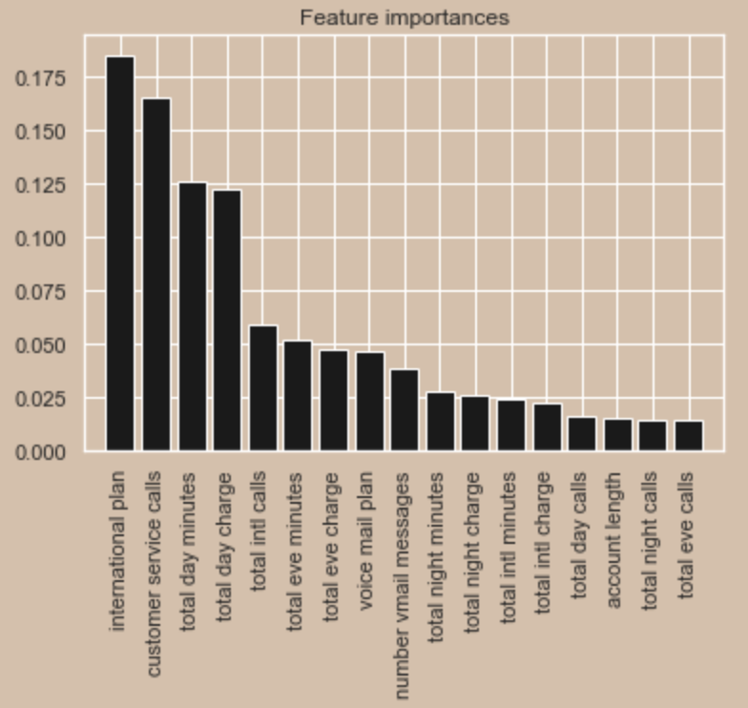
Modeling
Model predicts 98.7%
Important features include:
international plan
customer service calls
total day minutes
total day charge
total intl calls

Slide 7
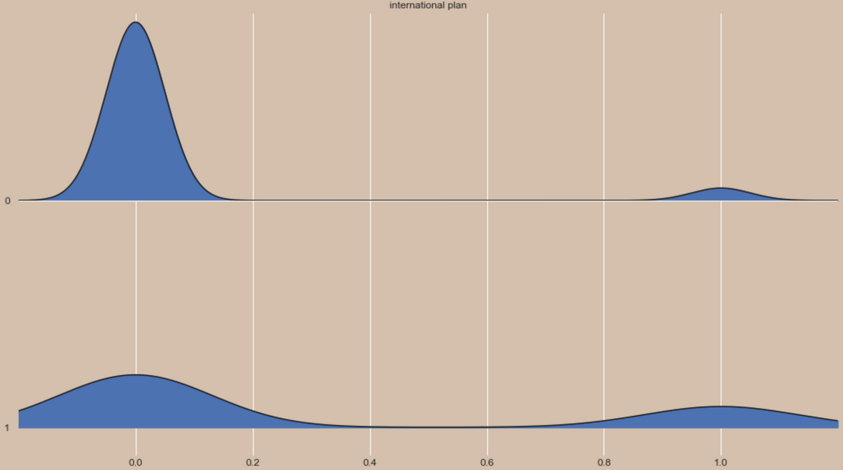
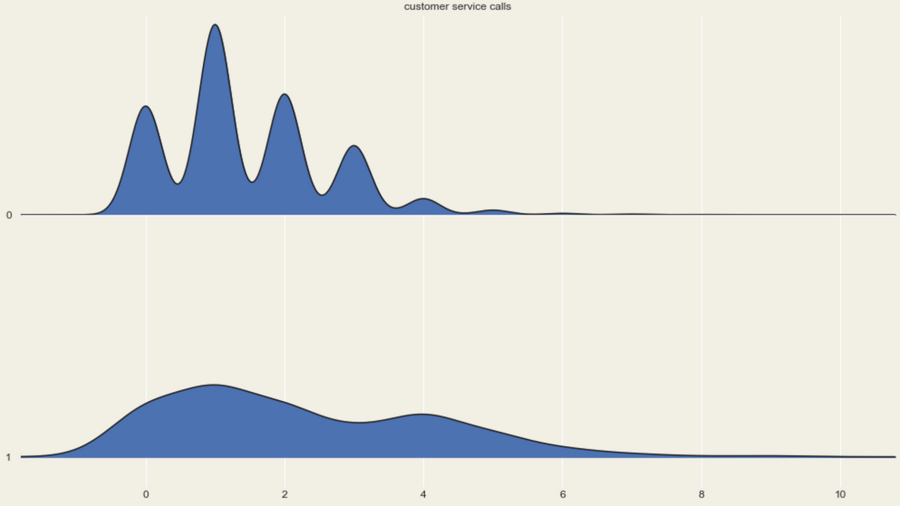
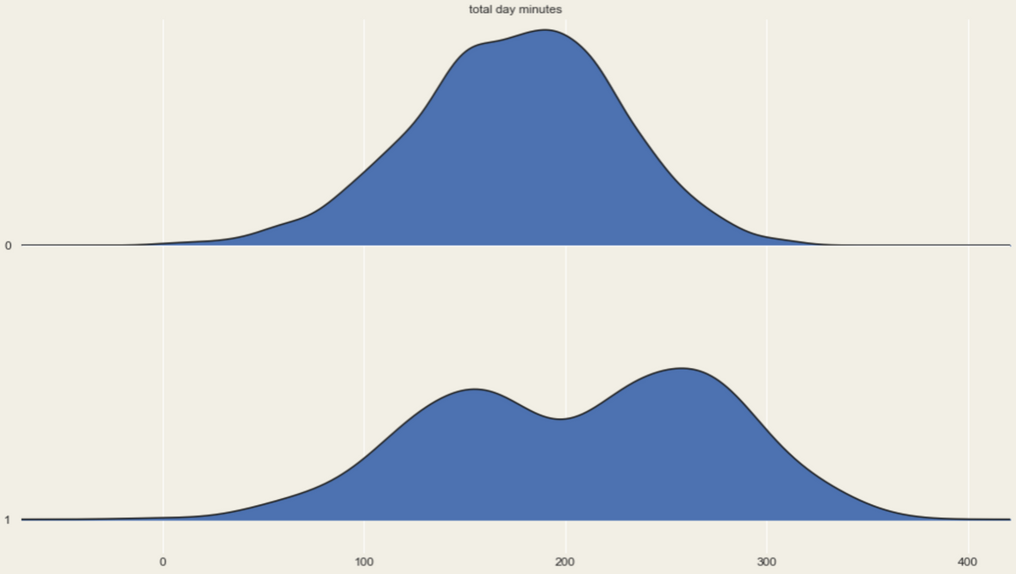
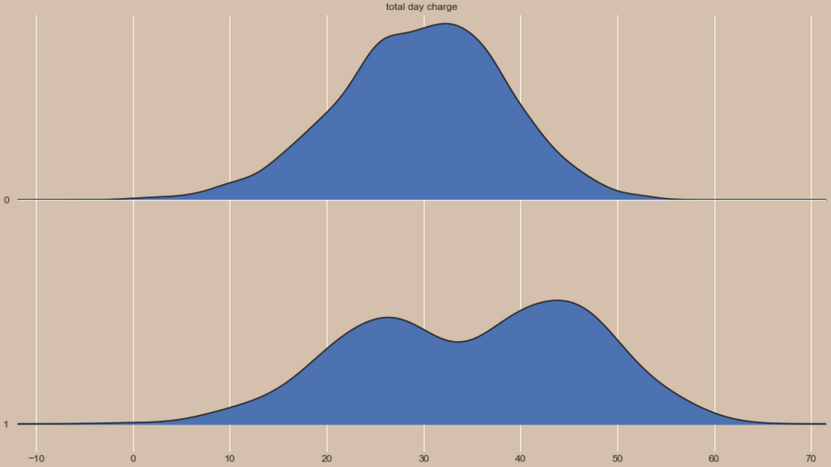
0
0
International Plan
Customer Service Calls
1
1
0
0
Total Day Minutes
Total Day Charge
1
1

Slide 8
Observations
People who have intl plans are more likely to churn
People who have more customer service calls are more likely to churn
People who talk more are more likely to churn
Due to higher charges or unhappy services?

Slide 9
Recommendations
Identify reasons what makes customers with intl plans unhappy
Reduce number of times people have to call customer service
Have better customer service
Offer better plans for customers who talk more
Possible higher immigrant population causing increase in intl plans

Slide 10
Next Steps
Between Two Churns, INC
Run the model for specific states
Fire customer service management
Give CEO $10 million bonus for doing nothing

